Slide 1
Lending Club Case Study
Group Members:
Siddhi Shree
Vaishno Jha

Slide 2
Problem Statement
Lending Club specializes in providing a diverse range of loans to urban clientele. Upon receipt of a loan application, the company is tasked with making a loan approval determination grounded in the applicant's profile.
Associated Risks
Not approving the loan for creditworthy applicants leads to business loss.
Approving high-risk loans may lead to company losses.

Slide 3
Objective
- The company aims to comprehend the influential factors behind loan defaults, specifically the variables that strongly signal potential defaults.
- This understanding can be harnessed by the company to enhance its portfolio management and risk evaluation strategies.

Slide 4
Understanding the data
Based on our initial observation, we have gathered the following insights and grasp of the data and its dimensions:
39717 rows and 111 columns
Size: 33MB
Over 60 rows have either single values or only null values.
Data has variety of data type: integer, float, strings, sentences, links, etc.
Possible Scenarios: Fully Paid, Current, Charged-Off

Slide 5
Steps of Data Analysis
Data Cleaning
Univariate Analysis
Bivariate Analysis
Segmented Analysis
Derived Analysis

Slide 6
Data Cleaning Steps
Removed columns with single or null values
Removed Columns with more than 10K null values
Removed unnecessary columns
Reformatting of columns
Filtering rows based on column
Filtering Rows with null column values
Removing outliers

Slide 7
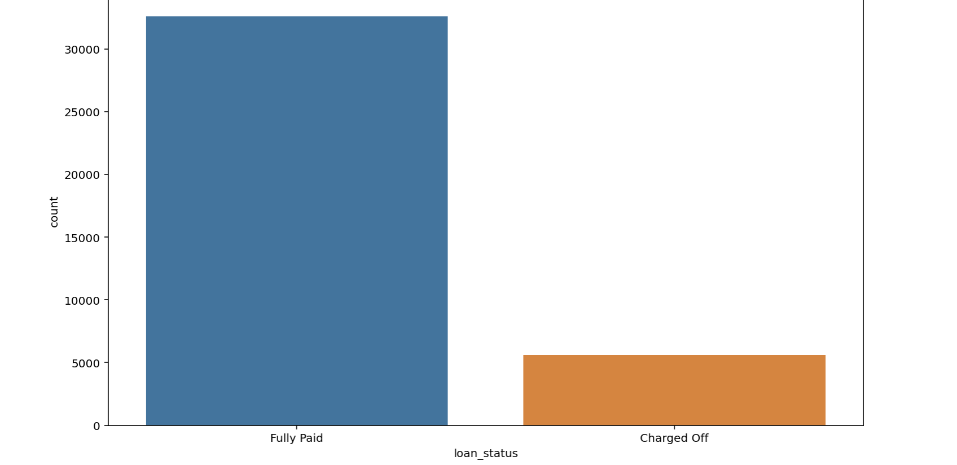
Univariate Analysis: Loan Status
The number of defaulted loans is very low in comparison to fully paid loans.

Slide 8
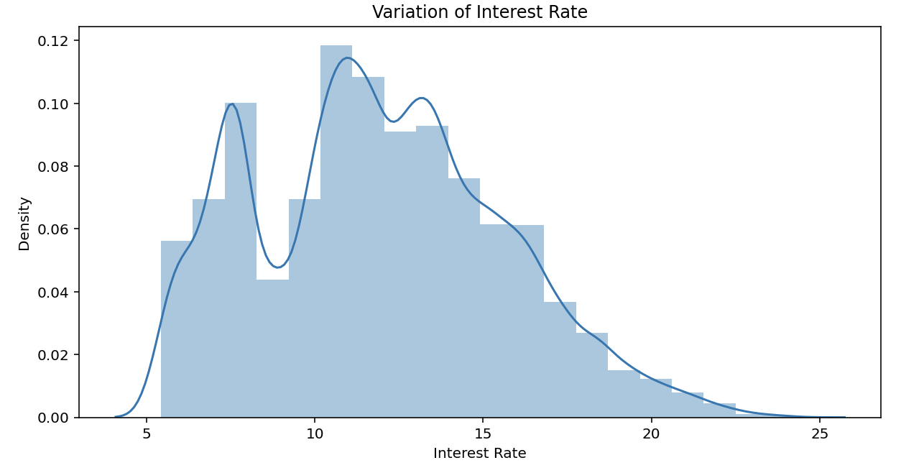
Univariate Analysis : Interest Rate
The interest rate shows more concentration within the ranges of 5-10 and 10-15, with a dip occurring around 10.

Slide 9
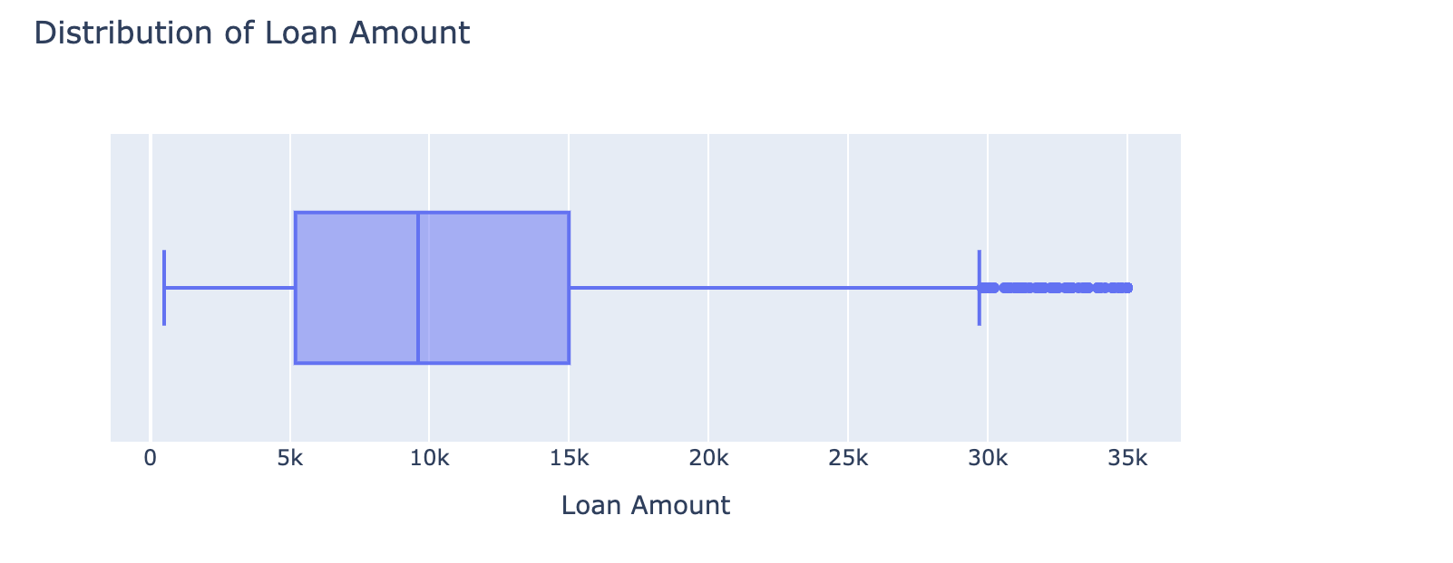
Univariate Analysis: Loan Amount
The loan amount ranges between 500 and 35000, with an average of 9800.

Slide 10
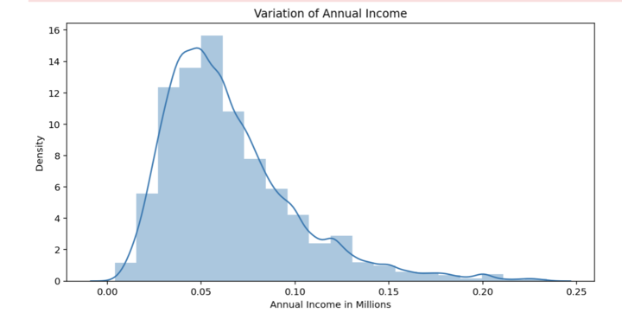
Univariate Analysis: Annual Income
Annual income has a skewed distribution, with most borrowers having lower income than the general population.

Slide 11
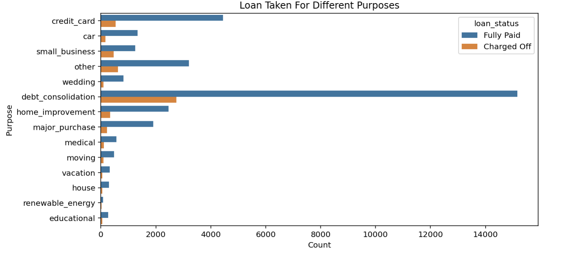
Segmented Univariate Analysis : Purpose
Debt Consolidation stands as the most prevalent loan purpose, boasting the highest count of both fully paid and defaulted loans.

Slide 12
Segmented Univariate Analysis
The mean and 25th percentile are identical for both, yet there's a notable increase in the 75th percentile for defaulted loans, suggesting that larger loan amounts have an elevated likelihood of default.
The probability of defaulting is greater for the 60-month term compared to the 36-month term, while the 36-month term exhibits a higher likelihood of loans being fully paid.
Borrowers who own their property experience fewer defaulted loans in comparison to those who are on a mortgage or renting.

Slide 13
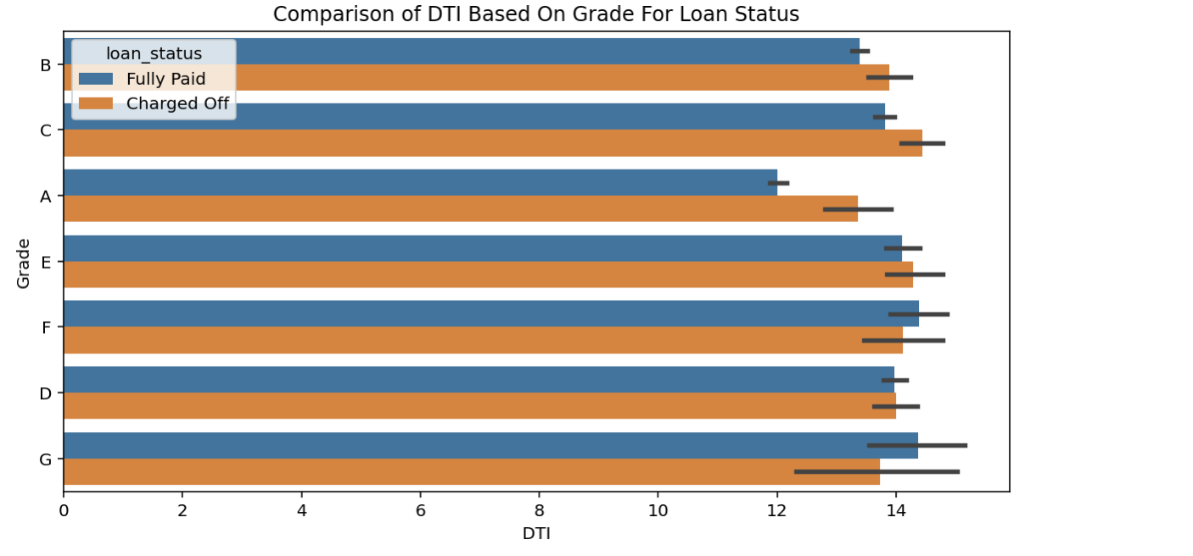
Bivariate Analysis
Grade A, representing the lowest risk, exhibits the lowest Debt-to-Income (DTI) ratio, suggesting a correlation where higher grades correspond to lower default rates.

Slide 14
Bivariate Analysis
The majority of borrowers have no history of Public Recorded Bankruptcy, making them a secure option for loan issuance.
The interest rate for charged off loans is pretty high than that of fully paid loans in all the loan_amount groups.
The grade serves as an indicator of risk, implying that the interest rate rises in tandem with the level of risk.

Slide 15


